Slide 1
Building Best In Class Medical Affairs (MA) Capabilities / Team
Adapting To Local Needs – My MA Experience In India
MAPS 2017 – Maryland, 20-22 June 2107
Dr. Aamir Shaikh
Founder, Assansa
India

Slide 2
Session Outline
India – Often, Better Experienced Than Explained!
  Indian Health Care And Pharmaceutical Environment
Best In Class Medical Affairs (MA) Capabilities / Team
  An Aspiration - Best In Class MA Capabilities / MA Team
  The Cultivation - Cultivating The Key MA Competencies And MA Mindset
Adapting To Local Needs – My MA Experience In India
  Few Personal Reflections And Learning

Slide 3


India - Often, Better Experienced Than Explained!

Slide 4
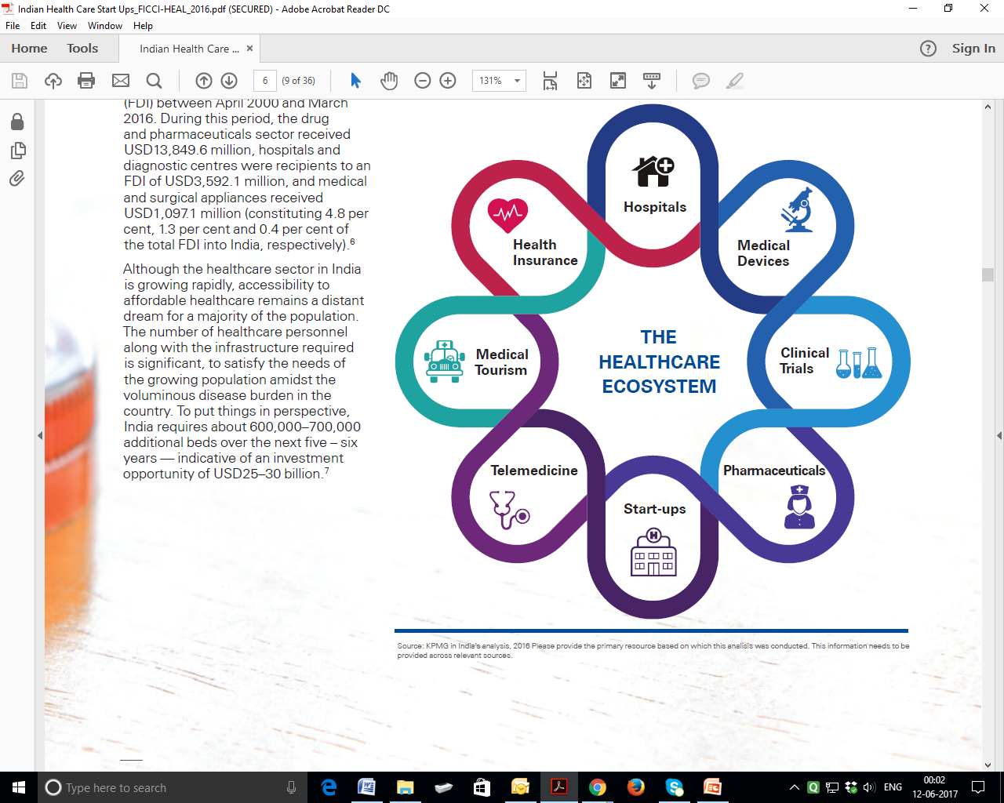
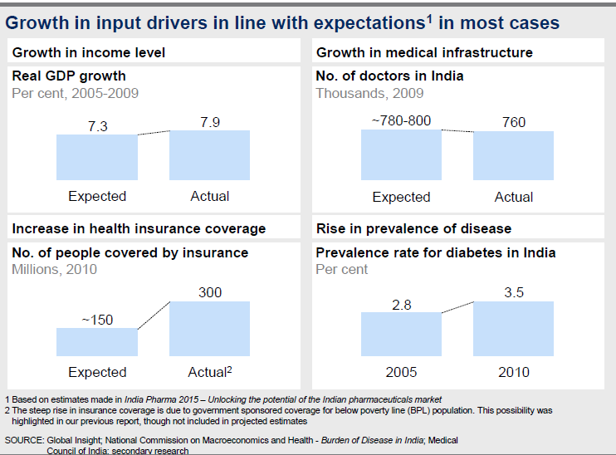
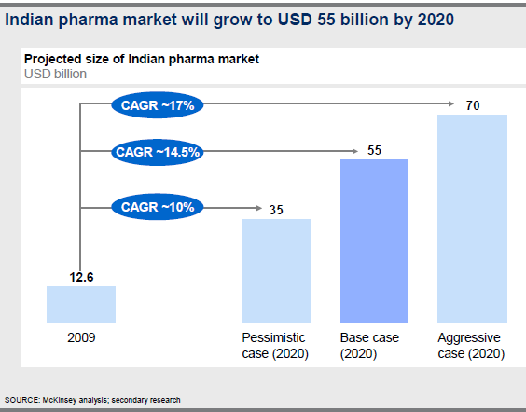
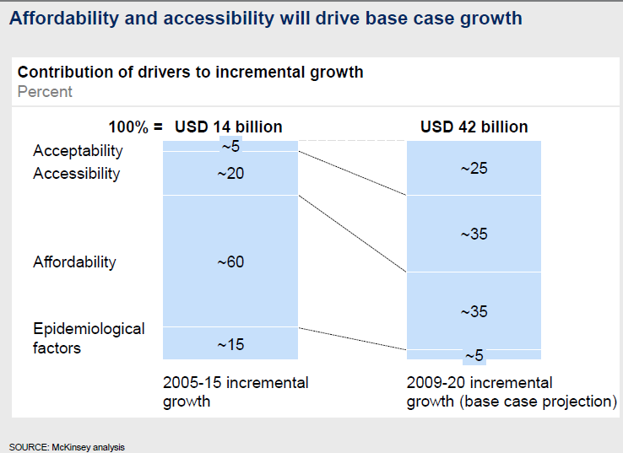
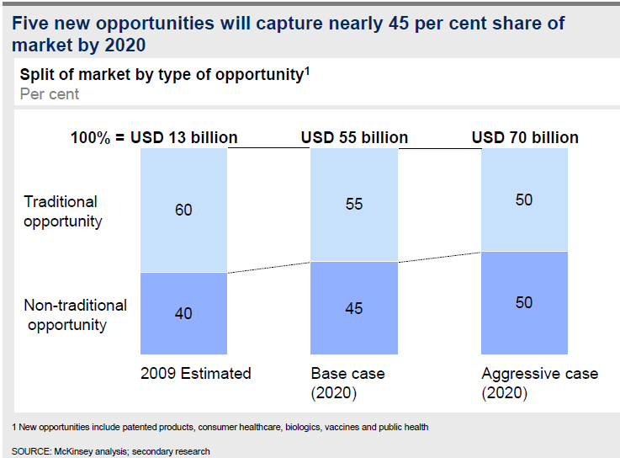
  Indian Health Care And Pharmaceutical Environment A Brief Overview, And The Journey To 2020….

Slide 5
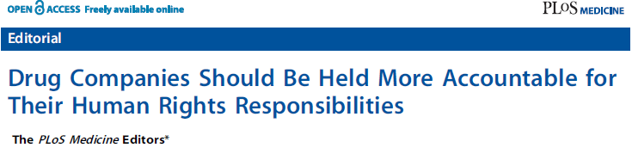
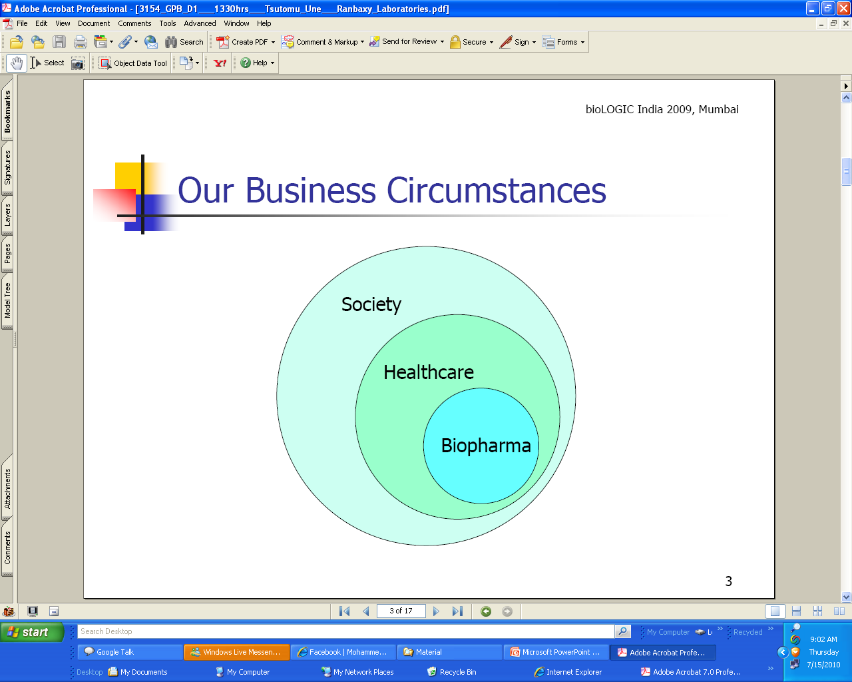
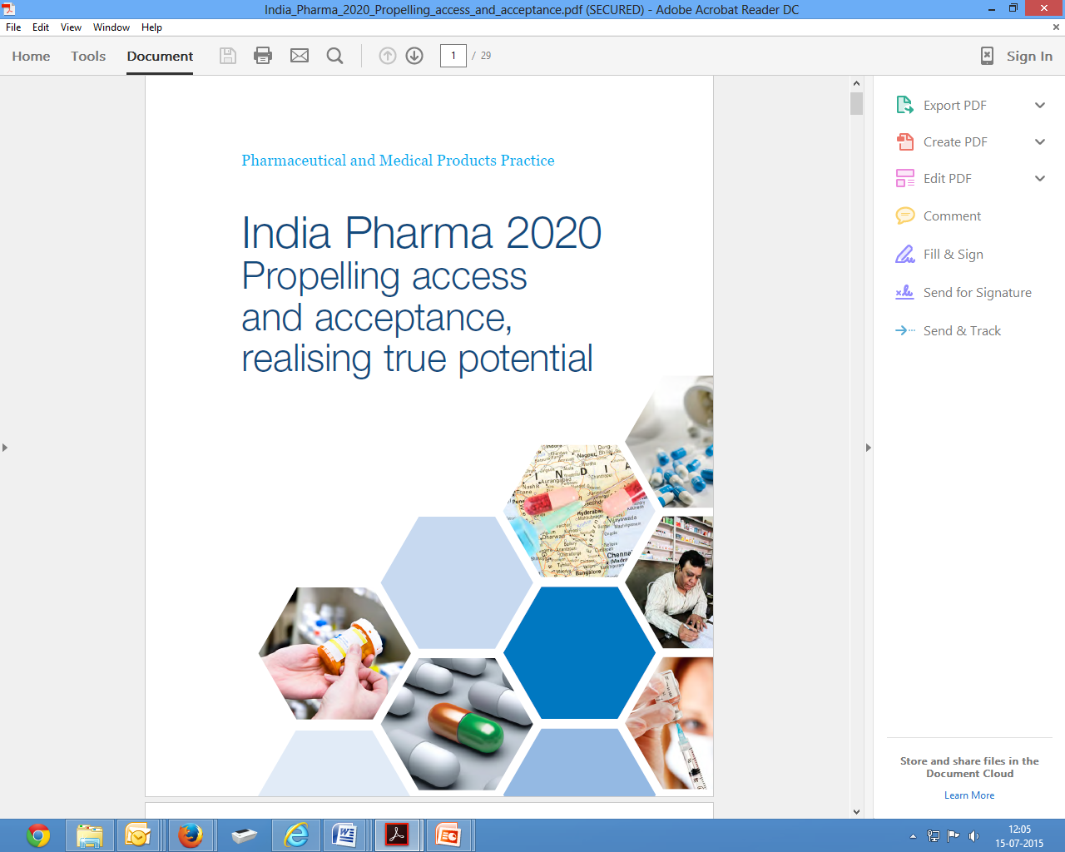
India’s Pharmaceutical Industry
Shouldering Greater Human Rights And Social Responsibility
Then, The 4 Ps
Product
Price
Place
Promotion
Now, The 4 Ps..
Product
Patient
Physician
Payer
… Also The 4 As
Awareness
Acceptability
Affordability
Accessibility
“Medical Affairs” Must Contribute, and Must Often Lead and Show the Way…

Slide 6
An Aspiration - Best In Class MA Capabilities / MA Team
Be “Sought And Selected” From The Best Available MA Talent Pool
Undergo Rigorous Education And Training To Build “Sound “MA Capabilities” - “Competencies, Mindset, Governance, Culture, And MA Teams” - Visible Success
Build And Manage “Internal Interfaces” With Marketing, Sales Teams, And Others – Strive For A “Sound Medical-Marketing Partnership” - Deliver Well For The Organization
Create, Nurture, And Leverage “External Customer Relationships”, Built On Ethical And Scientific Platforms - Deliver Well For The External Stakeholders
Be “Recognized, Respected And Trusted ” By Patients, Health Care Professionals / Medical Community / Other Stakeholders
Derive “Professional Development, Personal Enrichment And Growth” Through Career
At All Levels, “Lead And Be Led” By Sound Managers And Leaders – Sound People Demonstrating Wholesome Leadership

Slide 7

Successful Interactions Between MA Professionals
And HCPs / Clinicians Largely Depends On…
“The pharmaceutical industry uses external clinical experts extensively in deciding research policy, evaluating problems and arriving at solutions. However, experience shows that unless the pharmaceutical physicians who interact with these external experts are of similar calibre, both intellectually and clinically, the relationship does not function well. This is as much medical work as a case conference in a hospital.”
Cultivating The Key MA Competencies And MA Mindset

Slide 8
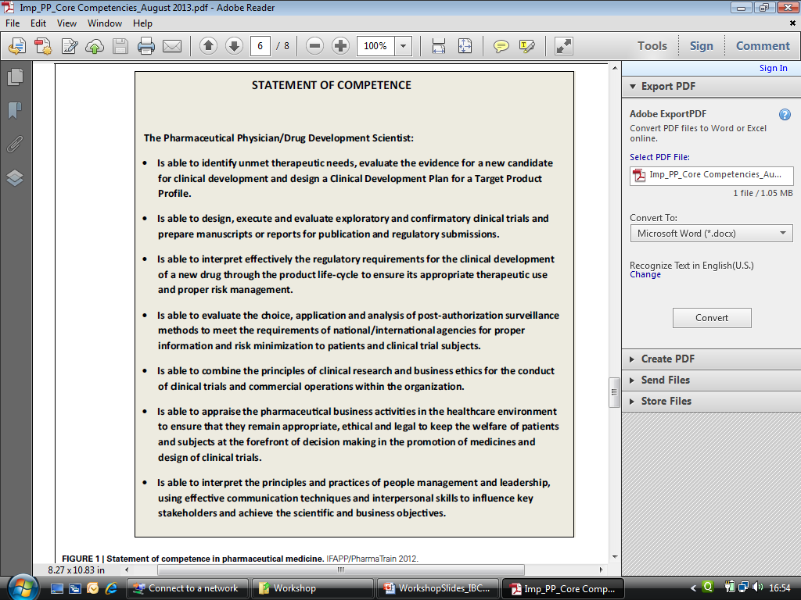
Cultivating The Key MA Competencies
MA Competency Theme
Statement Of Competence (On The Job)
1) TA Knowledge / New Product Evaluation / Development
2) Clinical Trial Evaluation, Design, Execution, Publication
3) Regulatory And Life Cycle Management
4) Post Marketing Commitments And Benefit / Risk Management
5) Aligning Science, Commerce and Business Ethics
6) Pharmaceutical Business Operations, HCP/KOL Interactions
7) People Skills , Management, Leadership, TL/KOL Engagement
Source: Adapted. Statement of competence in pharmaceutical medicine.
IFAPP/PharmaTrain2012. Frontiers in Pharmacology Pharmaceutical Medicine and Outcomes Research August 2013 Volume4 Article105

Slide 9
Cultivating The MA Mindset
This MA Mindset Is Characterized / Demonstrated By:
Accountability: To Self, And Multiple Stakeholders
Balance: Coupled With Sound Judgment And Decision Making
Clarity: Purpose, Thought, Speech, And Action
Developmental Focus: Towards Business, Self, And Others
Ethical Approach: In Thought And Behavior, And Integrity In Action

Slide 10

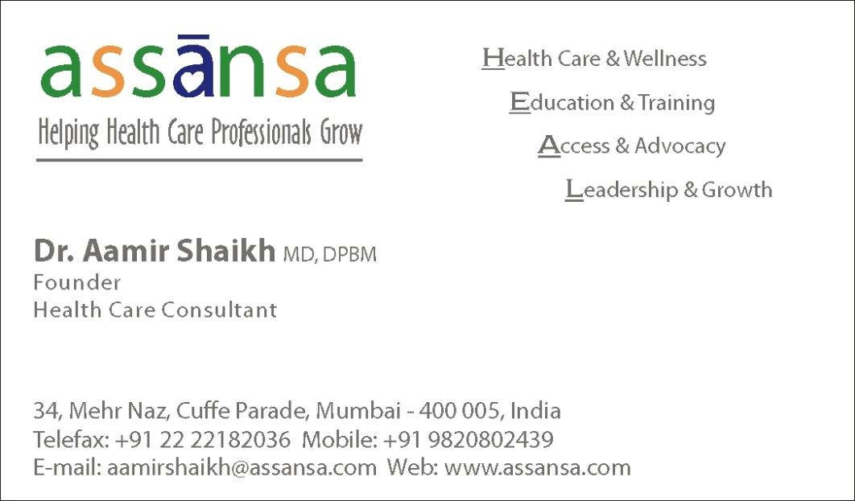
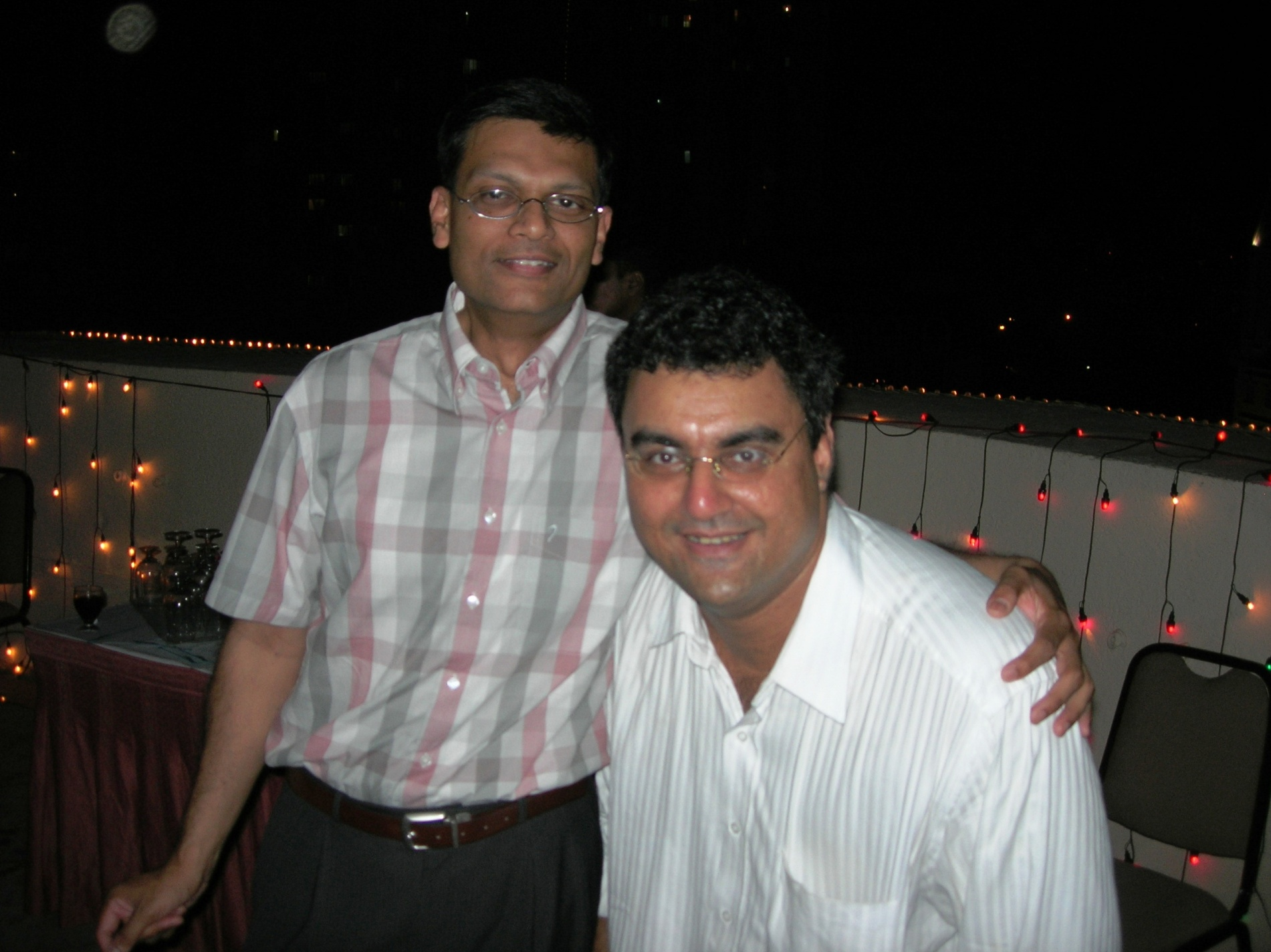
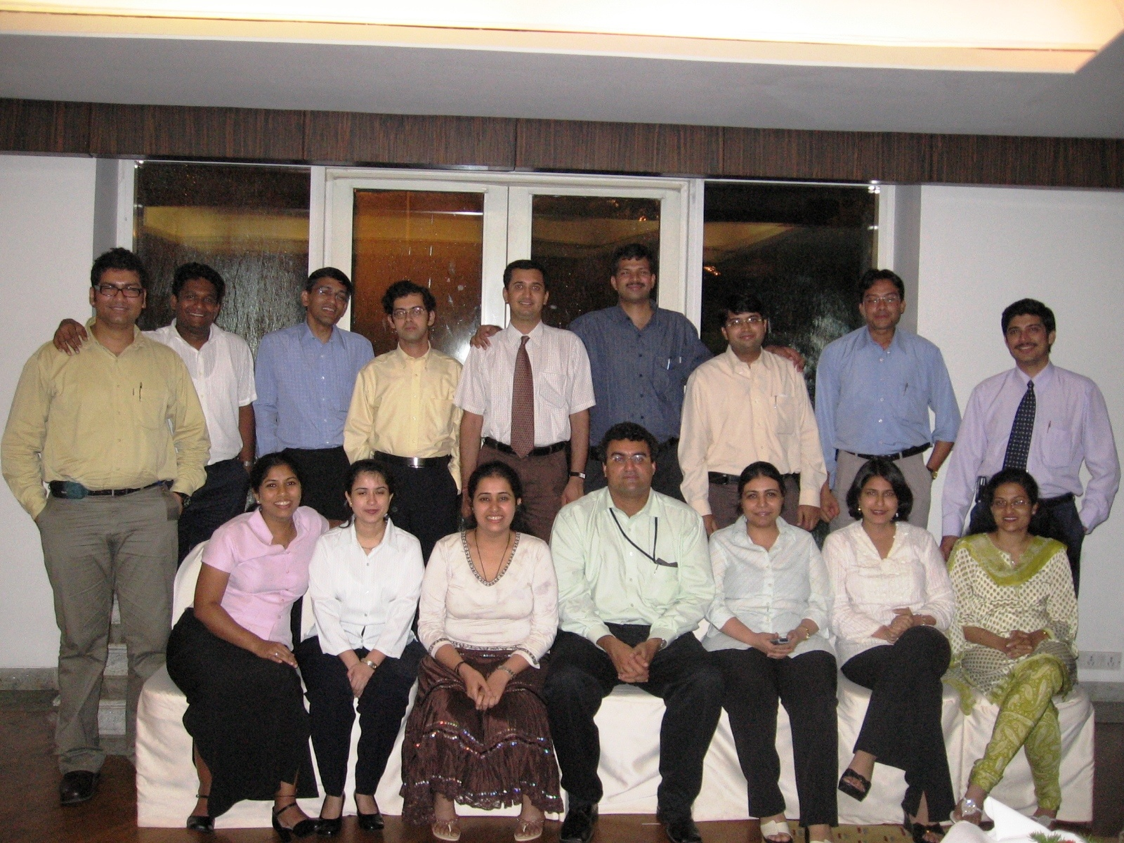
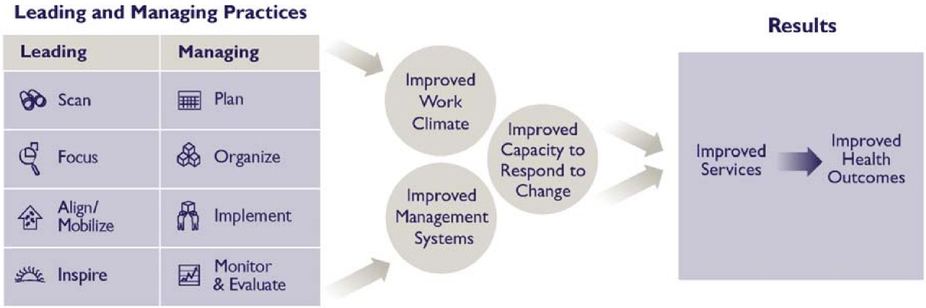










  Adapting To Local Needs - My MA Experience From India
  Few Personal Reflections And Learning (1997 - 2017…)
1998 - 2007
2007 – 2017…
HCP Health Care Domains
Doctor - Clinician
Researcher - Scholar
Educator - Teacher
Administrator - SP
Mentor - Leader

Slide 11

Share Knowledge!
Support Open Access!

